Slide 1


Multi-Bank Payment Optimization System
Project Title: Multi-Bank Payment Optimization System
Course Details: CSL2020, Data structure and algorithms, Prof. Suchetana Chakraborty
Mentor TA: Akanksha Dwivedi (P23CS0002), Sanidhya S. Johri (B20CS061)
Team Members: Raj Vijayvargiya (B22ES004), Dikshit Kumar (B22BB021), Hritin Raj (B22ES015), Abhishek Sharma (B22BB002)
Github Link

Slide 2
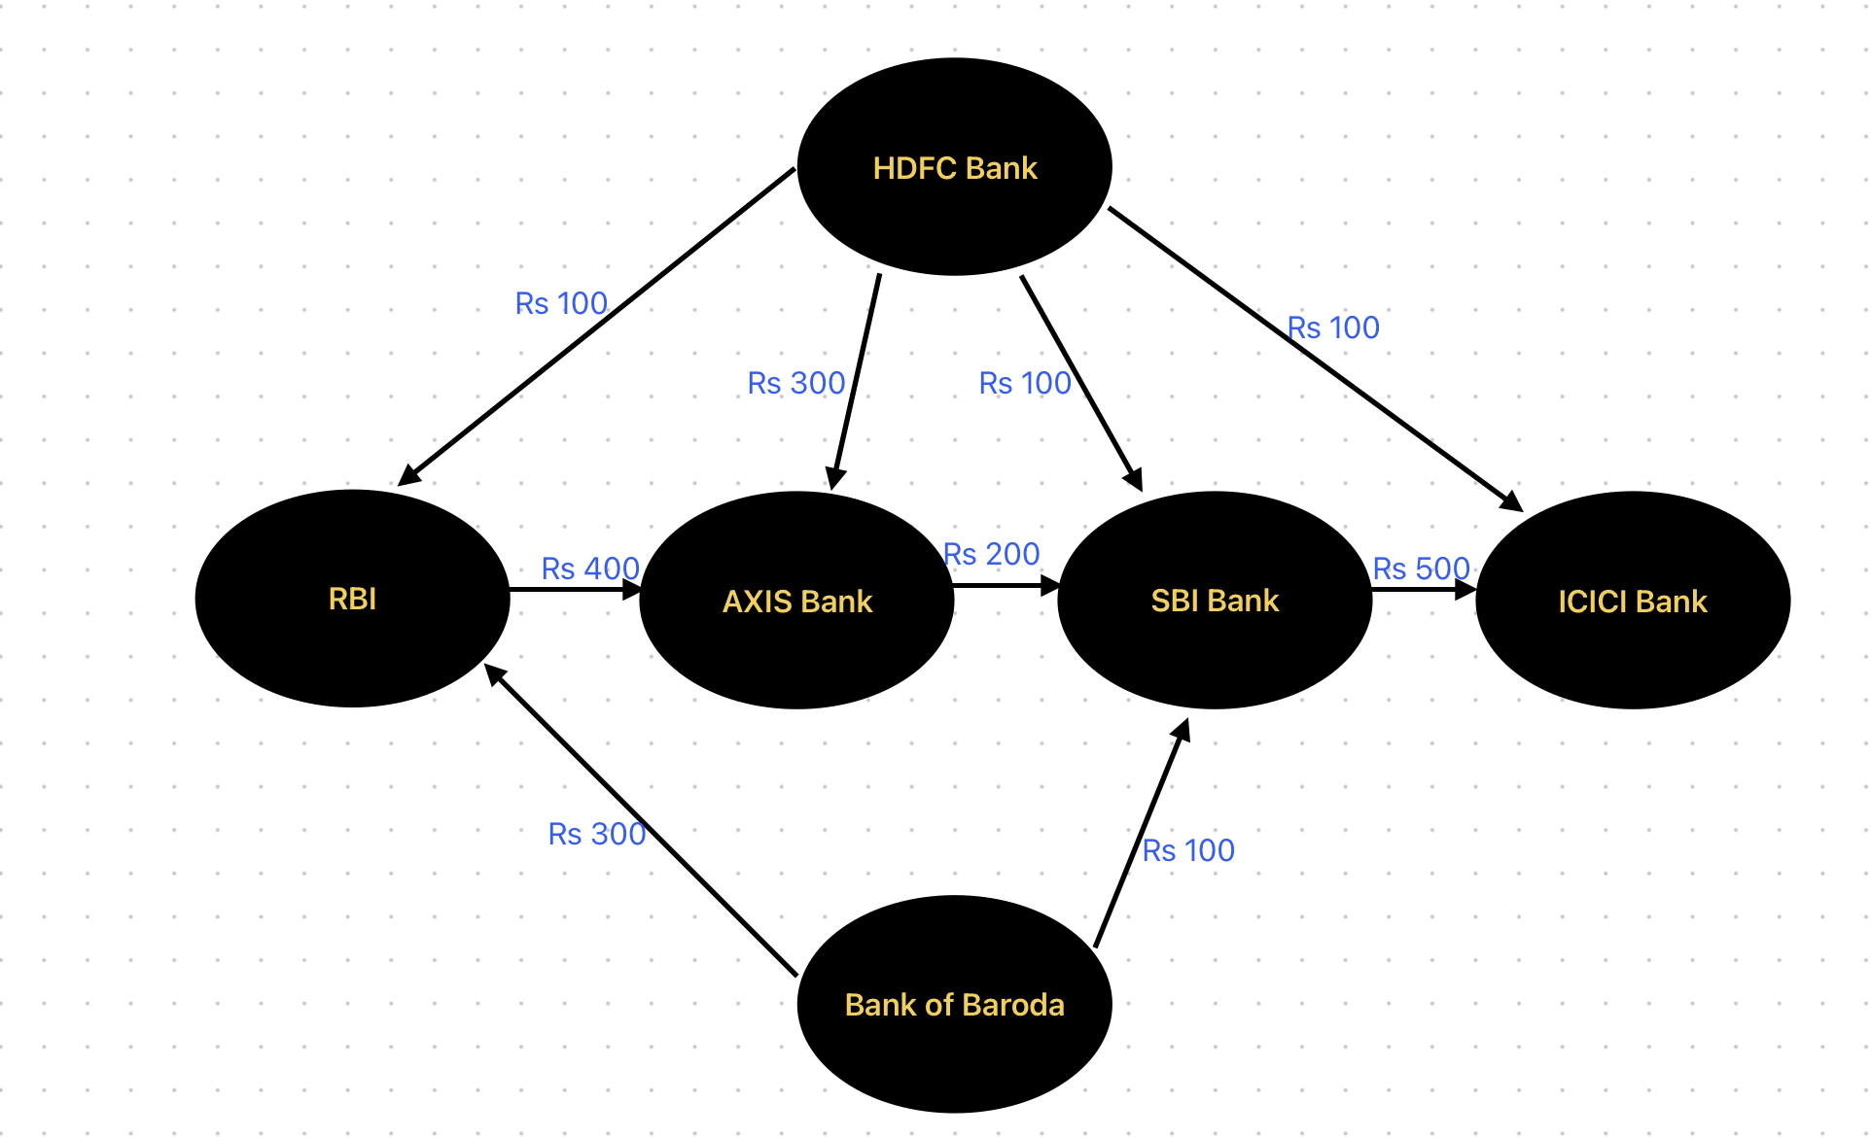
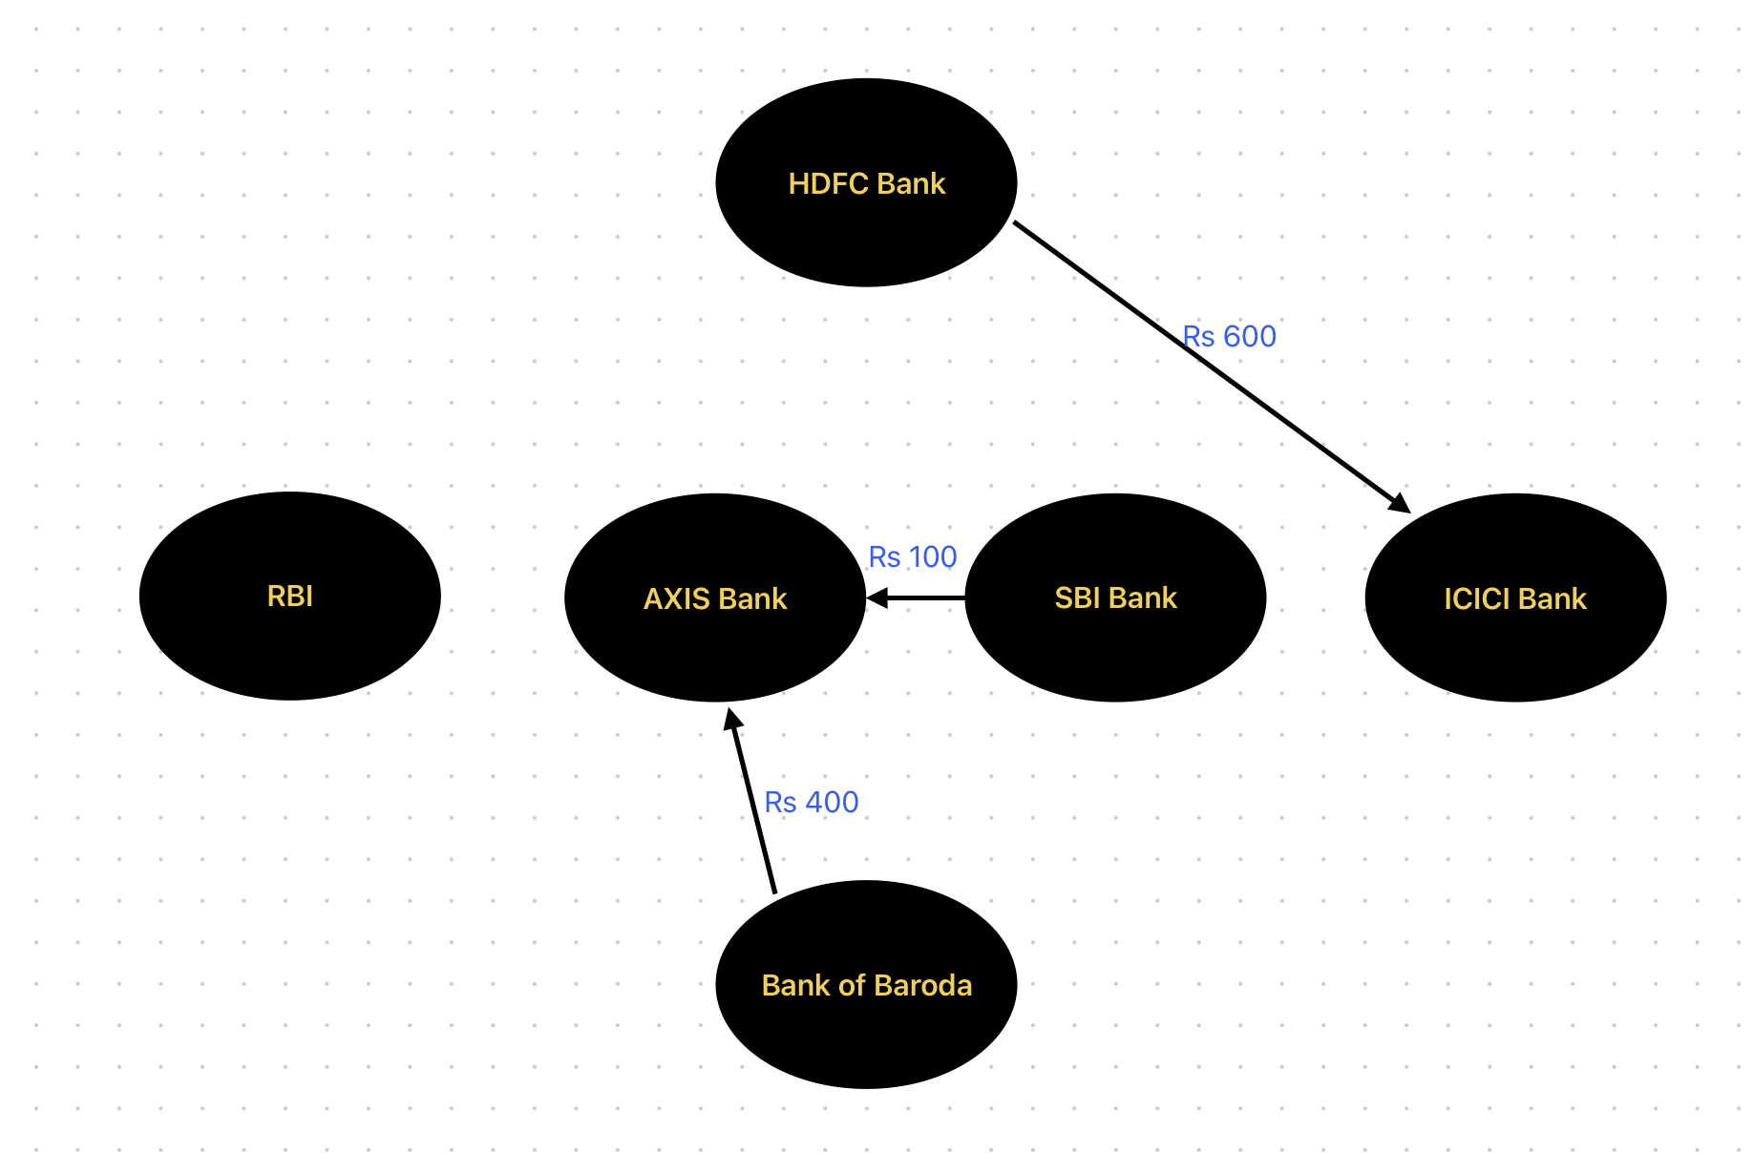
Problem Statement
1
Introduction
This innovative system aims to revolutionize the banking industry by optimizing cash flow and reducing transactional complexities across multiple financial institutions. Leveraging advanced data structures and algorithms, our team has developed a comprehensive solution to enhance financial efficiency and streamline cross-border payments.

Slide 3
2
Domain
3
Importance
Finance and banking sector.
Enhancing financial efficiency and reducing transactional complexities.
4
Challenges
5
Why data-driven solution looks promising?
Managing multiple payment modes, minimizing costs, and ensuring equitable funds distribution.
Data-driven solutions promise improved decision-making, enhanced efficiency, customized offerings, risk mitigation, scalability, flexibility, and competitive advantage in optimizing cash flow management for banks.

Slide 4


Current Status
1
Research Overview
~ Manual reconciliation methods still prevalent, though prone to errors and lack scalability.
~ Automated reconciliation systems improving efficiency but require significant investment.
2
Limitations Identified
~ Manual reconciliation methods are time-consuming, error-prone, and lack scalability.
~ Automated systems require significant investment and may not fully address complex cash flow optimization needs.
3
Opportunities Recognized
Utilizing machine learning algorithms to predict future cash flows and optimize transactions.
Implementing blockchain technology for secure and transparent financial transactions among multiple banks.

Slide 5

Existing Approaches
Traditional Methods
Manual reconciliation processes and outdated banking systems.
Challenges
Handling diverse payment modes across different banks.
Ensuring scalability to accommodate increasing transaction volumes.
Addressing security concerns related to financial data.
Adapting to dynamic changes in banking regulations and policies.
Optimizing transaction routes efficiently in complex networks.

Slide 6
Proposed Solution
Multi-Bank Payment Optimization System
Results Highlighted
Optimized transaction flow among Indian banks with reduced number of transactions.
Minimized overall balance among banks, leading to efficient fund distribution.
Utilize a graph-based approach to model transaction flows between Indian banks.
Implement algorithms to minimize the number of transactions and balance among banks.
Cost Analysis
Cost-Benefit Trade-off
Implementation cost includes development time for coding and testing.
No direct financial cost incurred, but potential resource allocation required.
Initial investment in development and testing offset by long-term savings from optimized transactions.
Increased operational efficiency and reduced financial overhead justify the investment.

Slide 7




System Implementation
Graph Algorithms
Dynamic Programming
Hash Maps
Deploying efficient graph-based algorithms to model and optimize financial flows.
Leveraging hash maps for rapid data retrieval and processing.
Integrating dynamic programming techniques to enhance transactional efficiency.

Slide 8


Performance Evaluation
1
Transactional Efficiency
Evaluated algorithm efficiency in minimizing transactional complexity.
Analyzed performance metrics for quick and accurate processing.
2
System Scalability
Tested system's ability to handle increasing banks and transactions.
Ensured system performance under growing demands.
3
Robustness Testing
Assessed system resilience against errors and failures.
Identified vulnerabilities and ensured stable performance.

Slide 9
Conclusion
Summary of Innovation
Successful data-driven solution for optimizing Indian bank cash flow.
Demonstrated graph-based algorithms' importance in financial optimization.
Leveraged graph-based algorithms to minimize complexity and balance distribution.
Enhanced operational efficiency and reduced financial overhead.
Scope of Future Extension
Cost-Benefit Trade-off
Integrate machine learning for transaction pattern prediction.
Explore blockchain for secure transaction recording.
Initial investment in development and testing offset by long-term savings from optimized transactions.
Increased operational efficiency and reduced financial overhead justify the investment.

Slide 10

Acknowledgment and Contributions
Acknowledgment
Contributions
1.https://www.highradius.com/resources/glossary/cash-flow-optimization/
2. https://treasuryxl.com/blog/the-ultimate-guide-for-achieving-efficient-and-safe-multibank-cash-visibility-and-payments/
3. https://www.analyticsinsight.net/career-at-jp-morgan-learn-these-programming-languages-now/
Raj Vijayvargiya: Code (printTransactions), ppt, report writing, content finding
Dikshit Kumar: Code (getLargestIdx), ppt, content finding
Hritin Raj: Code (getMinIdx), report writing, content finding
Abhishek Sharma: Code (getMaxIdx), content finding

